Slide 1
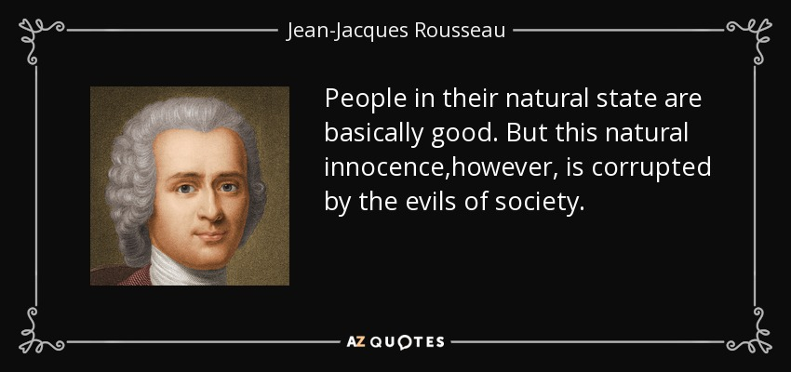
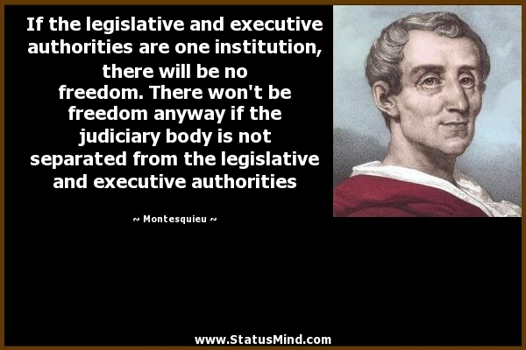
Enlightenment Thinkers
FRANCE
Montesquieu: separation of powers.
Rousseau: Social contract, popular sovereignty.

Slide 2
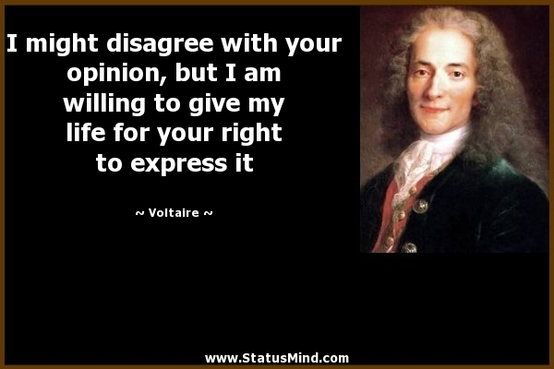
Voltaire: constitutional monarchy or republic (limited by a parliament); freedom of speech, thought and religion.
Dideron and D’Alembert: Encyclopédie

Slide 3
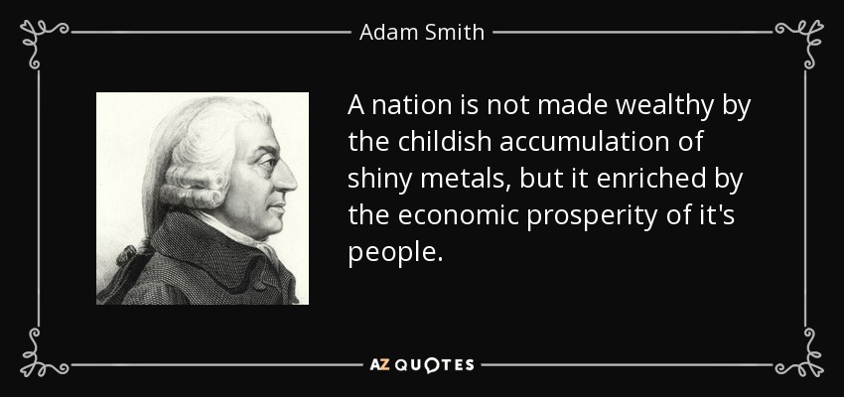
Enlightenment thinkers
United kingdom
Adam Smith: Modern economy. Physiocracy. Liberalism
John Locke and David Hume: empiricism (empirical evidence, experiments)
GERMANY
Immanuel Kant: Philosopher. Reason as source of morality and knowledge.

Slide 4
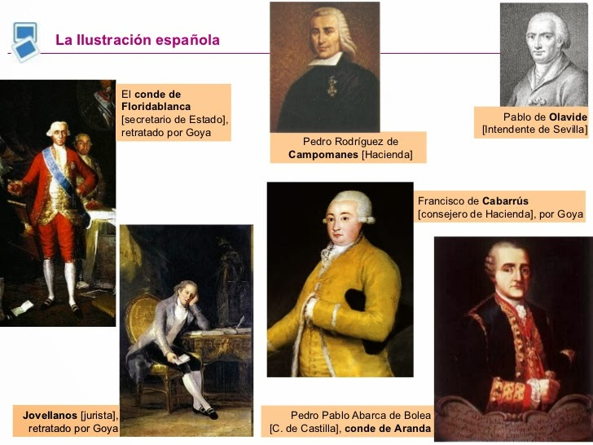
Enlightenment thinkers
SPAIN
Jovellanos, Floridablanca, Campomanes, Aranda, Ensenada, Olavide….
Ministers of the King Charles III. They are responsable for the educanional, political and economical (agrarian and commercial) reforms, etc.

